Slide 1
JavaScript Date Objects​
new Date() creates a new date object with the current date and time.​
var d = new Date();
new Date(year, month, ...) creates a new date object with a specified date and time.
7 numbers specify year, month, day, hour, minute, second, and millisecond (in that order):
6 numbers specify year, month, day, hour, minute, second.
5 numbers specify year, month, day, hour, and minute.
4 numbers specify year, month, day, and hour.
3 numbers specify year, month, and day.
2 numbers specify year, month.

Slide 2
JavaScript Date inputs
Type | Example
ISO Date | "2015-03-25" (The International Standard)
Short Date | "03/25/2015"
Long date | "Mar 25 2015" or "25 Mar 2015"

Slide 3
JavaScript Get Date Methods
getFullYear() Get the year as a four digit number (yyyy)
getMonth() Get the month as a number (0-11)
getDate() Get the day as a number (1-31)
getHours() Get the hour (0-23)
getMinutes() Get the minute (0-59)
getSeconds() Get the second (0-59)
getMilliseconds() Get the millisecond (0-999)
getTime() Get the time (milliseconds since January 1, 1970)
getDay() Get the weekday as a number (0-6)
Date.now() Get the time. ECMAScript 5.

Slide 4
JavaScript Set Date Methods
setDate() Set the day as a number (1-31)
setFullYear() Set the year (optionally month and day)
setHours() Set the hour (0-23)
setMilliseconds() Set the milliseconds (0-999)
setMinutes() Set the minutes (0-59)
setMonth() Set the month (0-11)
setSeconds() Set the seconds (0-59)
setTime() Set the time (milliseconds since January 1, 1970)

Slide 5
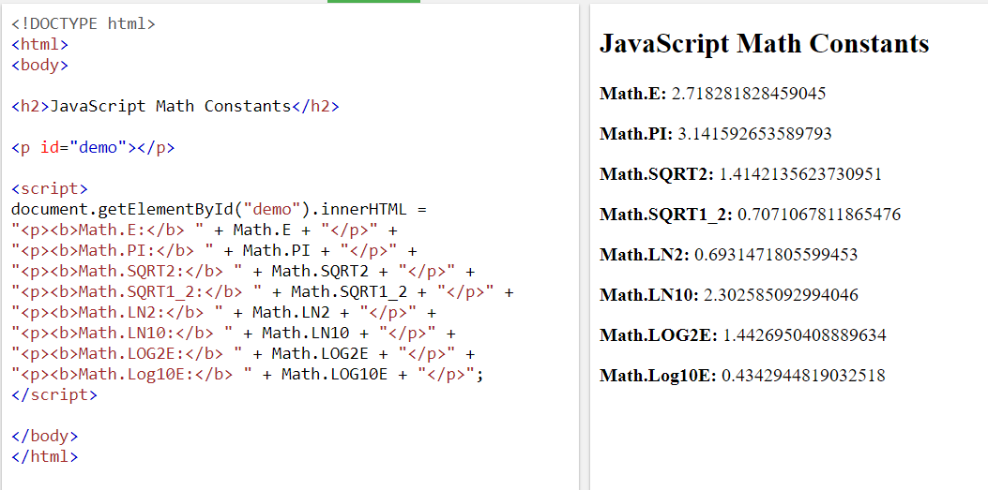
JavaScript Math Object

Slide 6
JavaScript Math Object
Math.round(x) returns the value of x rounded to its nearest integer:
Math.pow(x, y) returns the value of x to the power of y:
Math.abs(x) returns the absolute (positive) value of x:
Math.ceil(x) returns the value of x rounded up to its nearest integer:
Math.floor(x) returns the value of x rounded down to its nearest integer:
Math.sin(x) returns the sine (a value between -1 and 1) of the angle x (given in radians).
If you want to use degrees instead of radians, you have to convert degrees to radians:
Angle in radians = Angle in degrees x PI / 180.
Math.cos(x) returns the cosine (a value between -1 and 1) of the angle x (given in radians).
If you want to use degrees instead of radians, you have to convert degrees to radians:
Angle in radians = Angle in degrees x PI / 180.
Math.min() and Math.max() can be used to find the lowest or highest value in a list of arguments:
Math.random() returns a random number between 0 (inclusive), and 1 (exclusive):

